Slide 1
ACMA 231
Excel: Loan Calculator

Slide 2
Amortization
When you have a large spending (such as home or car purchase), it would be quite rare that you purchase it only with cash, so we would rely on the available loans to enable such purchases.
Once a loan was initiated, it should be repaid within the pre-determined term by making periodic payments (weekly, bi-weekly, or monthly).
Such process is called ‘Amortization’ – killing off the loan over time (recall the Latin root word ‘mort’ – which means death; also appears in mortgage).

Slide 3
Amortization Schedule
There are four main factors that interact and determine the amortization schedule;
  Annual percentage rate (APR)
  Length of the term
  Loan principal
  Periodic payment amount
If any three of above are given, than the remaining item is also determined by the amortization schedule (requires GOALSEEK function to solve for it).

Slide 4
Interactions among the factors
All else being equal, periodic payment amount would increase if
  APR increases,
  Loan principal increases, and
  Length of the term decreases.
Other than Excel, there are many available online calculators that offer amortization schedule.
https://www.calculator.net/finance-calculator.html
More details are available at ACMA 201 (time value of money, mortgage, bonds, etc…)

Slide 5
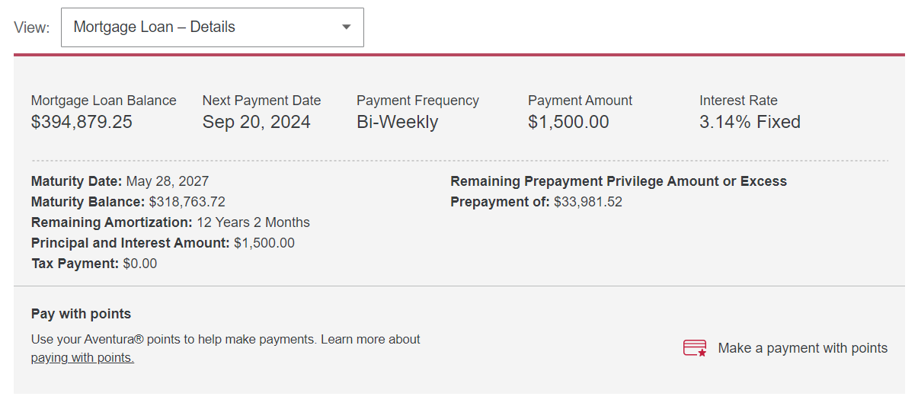
Example: Himchan’s mortgage
A mortgage needs to be renewed every 3 or 5 years in Canada!
(mine is 5 years fixed-rate)

